Slide 1
Database Design and Applications CSI ZG518/ SE ZG518/ SS ZG518
Prof Uma Maheswari S &
Prof Manjunath N

Slide 2
Course Title: Database Design and Applications
Course No: CSI ZG518/ SE ZG518/ SS ZG518
Credits:
5 (1 unit for lecture, 2 for self-study, 2 for lab / assignment / work integrated activities)

Slide 3
DSA course content
1. Introduction and Overview of DBMS
2. Conceptual Database Design (ER and EER Modeling)
3. Relational Model
4. Relational Algebra and Calculus
5. SQL
6. Schema Refinement and Normal Forms
7. Disk Storage
8. Hashing and Indexing
9. Transaction Management and Concurrency Control
10. Database Recovery
11. DB security
12. QUERY processing and optimization
13. Schema-less DB - NOSQL introduction.

Slide 4
From Taxila or LMS portal
Course evaluation
EC1 --------------------------------------> 30 marks
quiz 1 -- 10 marks (Aug 25 to Sept 5th)
quiz 2 -- 10 marks (Sept 25 to Oct 5th)
Project Assignment – 10 marks (Nov 20^{th)}
EC2 ---- Midterm exam ----> 30 marks (closed book exams)
EC3 ---- Comprehensive exam ---> 40 marks (open book exams)
---------------
TOTAL MARKS ---------------------> 100 marks
---------------

Slide 5
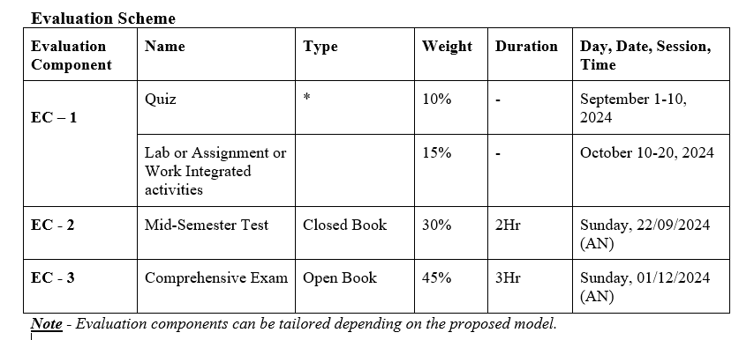

Slide 6
DDA course : Do’s and Don’t’s
Watch the RL in Taxila or LMS portal before coming to the class (details of session topic and its RL in the course handout)
During contact sessions solving problems related to that chapter or topic will be done.
You will have to practise problems given at the end of the chapter
Project/ assignment :
Every Student is allocated a project title.
There is project folder in your MS teams which has all guidelines and delivery files.
Project deliverables are to be shared with me in a google drive folder.
Exams Midterm and Comprehensive
Quizzes and Project – In case of unexpected situations and thereby if you cannot or will not be able to attend then let me know in advance (before the quiz starts and ends).

Slide 7
Session 1
Introduction to Database Management Systems (DBMS)
Concepts and Architecture

Slide 8
Learning Objective
Introduction to RDBMS
RDBMS vs Traditional FS
3-schema arch
data independence
DBMS architecture
Data dictionary,
DB design phases
Refer : T1-Chapter 1 and 2;
RL : 1.1 , 1.2

Slide 9
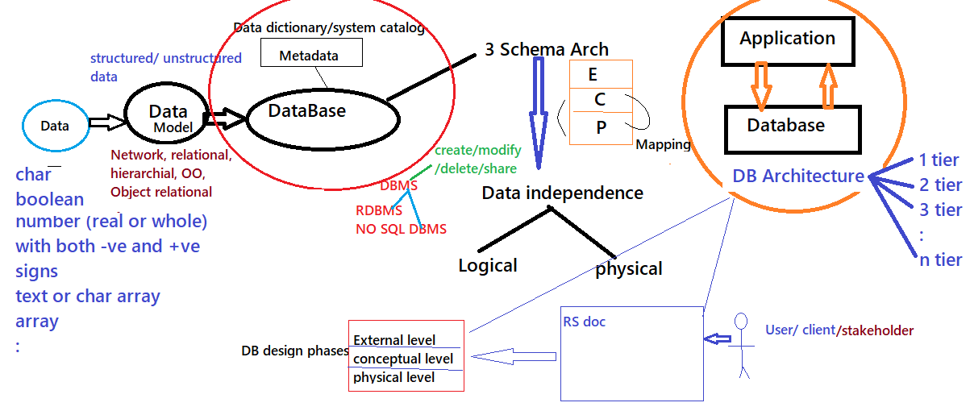

Slide 10
What is Data ?
A unit of Information is called DATUM while DATA is plural. So DATA is
Collection of related data
By data , we mean known facts that can be recorded and that have implicit meaning.
Represents some aspect of the real world
Logically coherent collection of data with inherent meaning
Built for a specific purpose

Slide 11
Types of Data
Examples
Character | A N $
Number | 12
 | 56.9
 | 54/78
 | -5.6777
 | 89,677
Date | 03-08-2019 1/5/2018
Currency | $56678 Rs 34900
Boolean | 1 or 0 true or false
Sets | {RED, YELLOW, GREEN BLUE} {USD, INR, AUD, EURO, POUND}

Slide 12
So What is Database ?
A unit of Information is called DATUM while DATA is plural. So DATA is
Collection of related data
By data , we mean known facts that can be recorded and that have implicit meaning.
Represents some aspect of the real world
Logically coherent collection of data with inherent meaning
Built for a specific purpose
This collection of related data with an implicit meaning is a database.

Slide 13
What is Database ?
DATABASE:
A collection of related data with an implicit meaning is called a Database.
Examples of Database:
employee database (contains all about employees from one or more branches of an organization),
E.g., Employee DB ➔
Employee details: each employee’s name, employee id no, ssn or NI or Aadhar , phone#, address, city, work location, which department, salary.
Department details: each Department has department name, dept number, no of employees working, head of dept or manager, locations
:
sales database (contains all about sales and salesperson from one or more branches of an organization),,
user database (all who uses the system and credentials and log details) and so on.

Slide 14
Database Size:
Size of database can big to small depends on the application’s usage of data that can be volume, variety, velocity, value and Validity of data.
A large database for databases with several dozen gigabytes of data and a schema with more than 30 or 40 distinct entity types, that cover a wide array of databases used in government, industry, and financial and commercial institutions.
Application systems for these databases are called transaction processing systems or TPS due to the large transaction volumes and rates that are required.

Slide 15
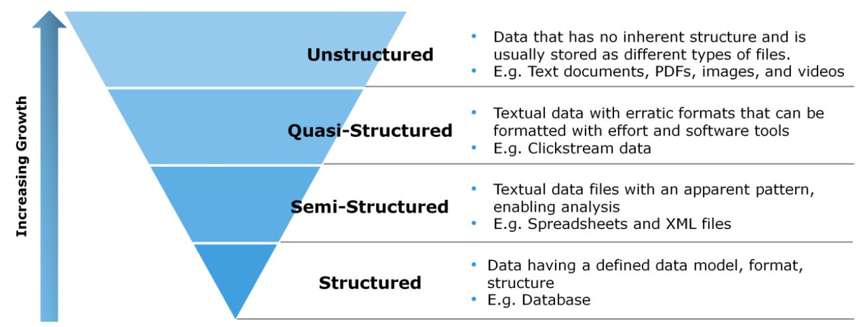
Types of data used by Applications:

Slide 16
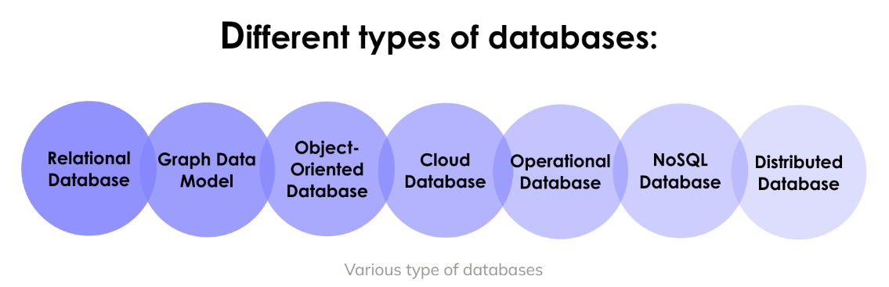
Types of Databases and Database Applications
Traditional database applications
Store textual or numeric information
Multimedia databases
Store images, audio clips, and video streams digitally
Geographic information systems (GIS)
Store and analyze maps, weather data, and satellite images
Data warehouses and online analytical processing (OLAP) systems or ANALYTICAL DB
Extract and analyze useful business information from very large databases
Support decision making
Real-time and active database technology
Control industrial and manufacturing processes
Time series DB
Financial data
the volatility of stock trading

Slide 17
DBMS and its OPERATIONS

Slide 18
What is Database management system (DBMS) ?
Collection of programs
Enables users to create and maintain a database
Def:
The DBMS is a general-purpose software system that facilitates the processes of defining, constructing, manipulating, and sharing databases among various users and applications
How do we share the DB ?
Server

Slide 19
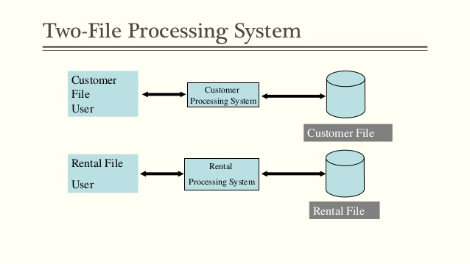
Traditional file processing

Slide 20
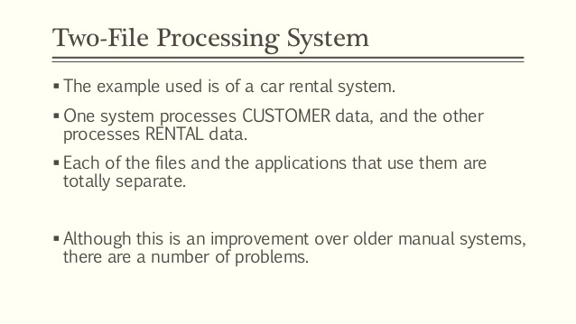
Traditional file processing

Slide 21
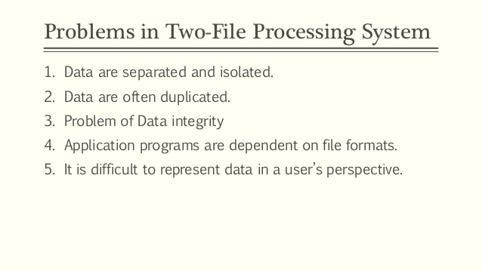
Traditional file processing

Slide 22
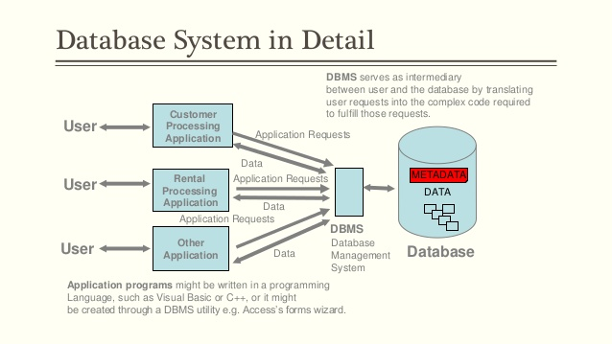
How does DBMS Look?

Slide 23
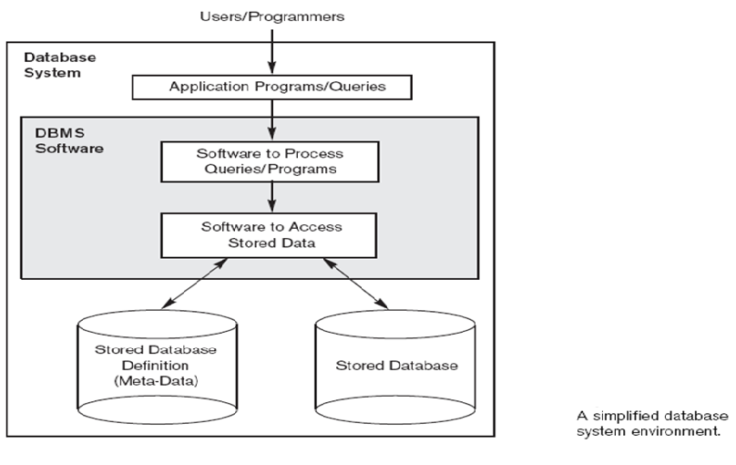
DBMS environment

Slide 24
What operations can you do with DBMS?
Defining a database
Constructing the database
Manipulating a database
Sharing a database
Query a database

Slide 25
DBMS operations in detail
Defining a database
Specify the data types, structures, and constraints of the data to be stored.
The database definition or descriptive information is also stored by the DBMS in the form of a database catalog or dictionary; it is called meta-data.
Constructing the database is the process of storing the data on some storage medium that is controlled by the DBMS.
Manipulating a database includes functions such as querying the database to retrieve specific data, updating the database and generating reports from the data.

Slide 26
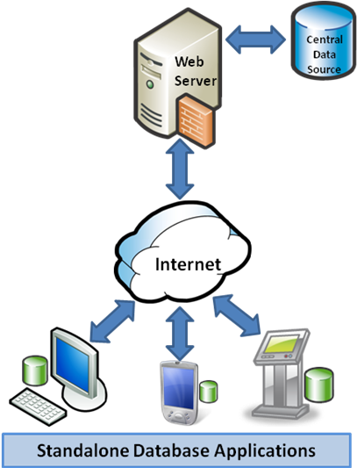
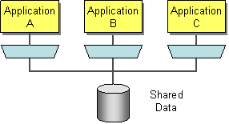
What is sharing operation in DBMS?
Sharing a database allows multiple users and programs to access the database simultaneously.

Slide 27
How do we access Database from application programs?
An application program can access a database by sending queries to DBMS using:
Three main integration approaches:
– Embed SQL in the host language (Embedded SQL)
– Create special API to call SQL commands (JDBC,ODBC)
– Allow ‘external’ code to be executed from within SQL
What is Query ?
A DBMS operation that causes some data to be retrieved
Notes:
A query is like asking question to db.

Slide 28
Embedded SQL
{
int a;
/* ... */
EXEC SQL SELECT salary INTO :a
FROM Employee
WHERE SSN=876543210;
/* ... */
printf("The salary is %d\n", a);
/* ... */
}

Slide 29
Using SQL in API call
app.post("/api/getAllcustomers", (req, res) => {
const {eid } = req.body;
console.log("eid is ..",eid);
pool.query
"SELECT * FROM customers WHERE customercity= $1",
[eid],
(error, results) => {
if (error) {
console.log(error);
res.status(203);
}
else {
res.status(200).json(results.rows);
}
});
});

Slide 30
Allow ‘external’ code to be executed from within SQL
EXAMPLE OF PYTHON CODE EXECUTION IN SQL SERVER
To allow the use of external scripts in the Python language, you must enable the system parameter “external scripts enabled” in SQL Server, this is done using the system procedure sp_configure.
sp_configure 'external scripts enabled', 1;
RECONFIGURE WITH OVERRIDE
EXECUTE sp_execute_external_script
@language = N'Python',
@script = N'
a = 1
b = 2
c = a+b
print ("Example instruction on Python")
print("Result =", c)';

Slide 31
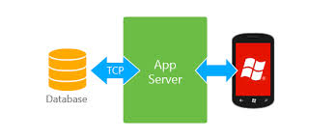
Mobile accessing a database?
Notes:
Using its application server.

Slide 32
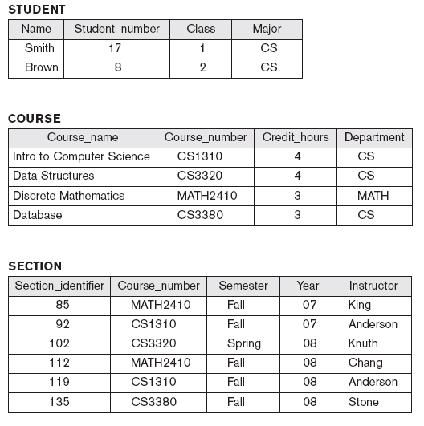
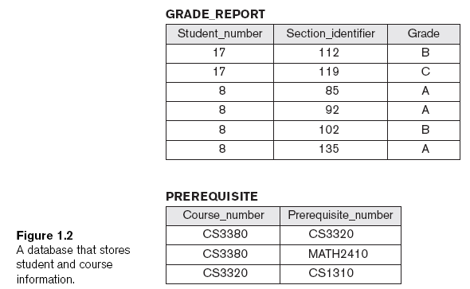
CASE STUDY: UNIVERSITY Database design

Slide 33
Examples of Queries and Updates:
Examples of queries:
Retrieve the transcript
List the names of students who took the section of the ‘Database’ course offered in fall 2008 and their grades in that section
List the prerequisites of the ‘Database’ course
Examples of updates:
Change the class of ‘Smith’ to sophomore
Create a new section for the ‘Database’ course for this semester
Enter a grade of ‘A’ for ‘Smith’ in the ‘Database’ section of last semester

Slide 34
Features of DBMS
Transaction and Concurrency Control
Data Security
Back-up and Restore
Data Integrity
Data Independence

Slide 35
What is Transaction in DB?
May cause some data to be read and some data to be written into the database
Eg.,
When you credit or debit in your bank account
Transaction 1:
A’s Account
Open_Account(A)
Old_Balance = A.balance
New_Balance = Old_Balance - 500
A.balance = New_Balance
Close_Account(A)
Transaction 2:
B’s Account
Open_Account(B)
Old_Balance = B.balance
New_Balance = Old_Balance + 500
B.balance = New_Balance
Close_Account(B)
Notes:
Eg., what happens when do a credit or debit and it updates the balance in your account.

Slide 36
Protection for DB?
Protection includes:
System protection (against hardware or software malfunction (or crashes))
Security protection (against unauthorized or malicious access)
Hacking db

Slide 37
What is “Maintain the DB system” ?
Allow the system to evolve as requirements change over time
Therefore it is an activity designed to keep a database running smoothly.
A number of different systems can do this:
1. performed by people who are comfortable and familiar with the database system and the specifics of the particular database
2. Databases are used to maintain a library of information in a well organized, accessible format. Database maintenance is used to keep the database clean and well organized so that it will not lose functionality.
3. Backing up the data
4. Checking for signs of corruption in the database
5. Server maintenance.

Slide 38
Database approach
Characteristics of the Database Approach :
1. Self-describing nature of a database system
2. Insulation between programs and data, and data abstraction
3. Support of multiple views of the data
4. Sharing of data and multiuser transaction processing

Slide 39
Database approach
Self-Describing Nature of a Database System
Database system contains complete definition of structure and constraints.
Meta-data
Describes structure of the database
Database catalog used by:
DBMS software
Database users who need information about database structure

Slide 40
Database approach
2. Insulation between programs and data implies “data abstraction”
Program-data independence
Structure of data files is stored in DBMS catalog separately from access programs
Program-operation independence
Operations specified in two parts:
Interface includes operation name and data types of its arguments
Implementation can be changed without affecting the interface

Slide 41
Database Approach
3. Support of multiple views of the data
View
Subset of the database
Contains virtual data derived from the database files but is not explicitly stored
Multiuser DBMS
Users have a variety of distinct applications
Must provide facilities for defining multiple views

Slide 42
Database Approach
Multiple views of the data

Slide 43
Database Approach
4. Sharing of data and multiuser transaction processing
Allow multiple users to access the database at the same time
Concurrency control software
Ensure that several users trying to update the same data do so in a controlled manner
Result of the updates is correct
Online transaction processing (OLTP) application
A multiuser DBMS software is to ensure that concurrent transactions operate correctly and efficiently.

Slide 44
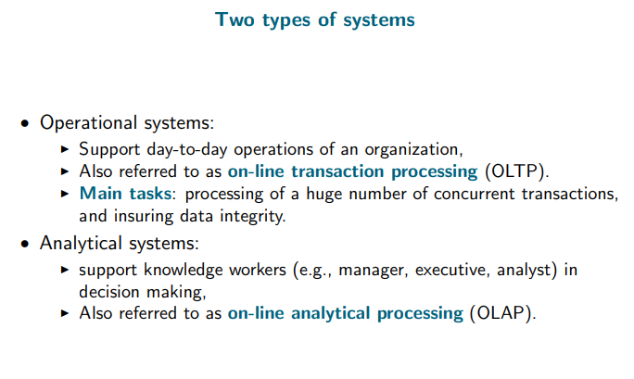
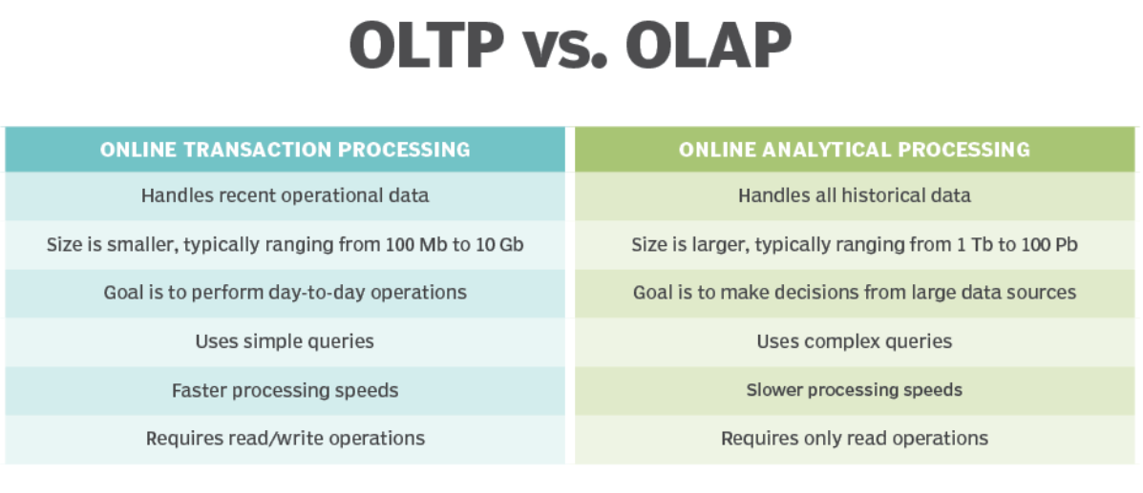

Slide 45
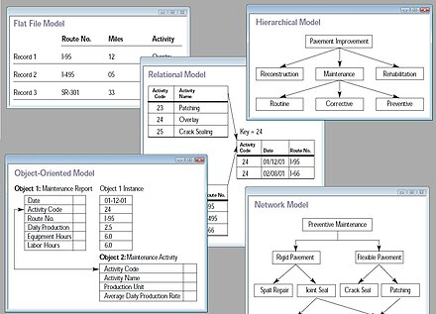

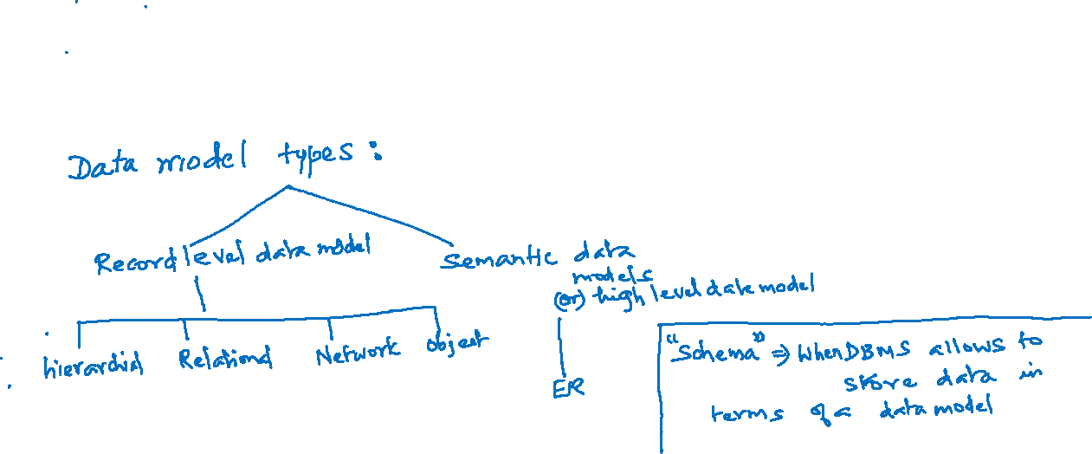
DATA MODEL
Data models define the logical structure of data, how they are connected and how the data are processed and stored in information systems.
Data models provide the conceptual tools for describing the model of an information system at the data abstraction level.
It enables users to decide how data will be stored, leveraged, updated, accessed, and shared across an organization.
Data models may also provide a portrait of the final system, and how it will look after implementation.

Slide 46
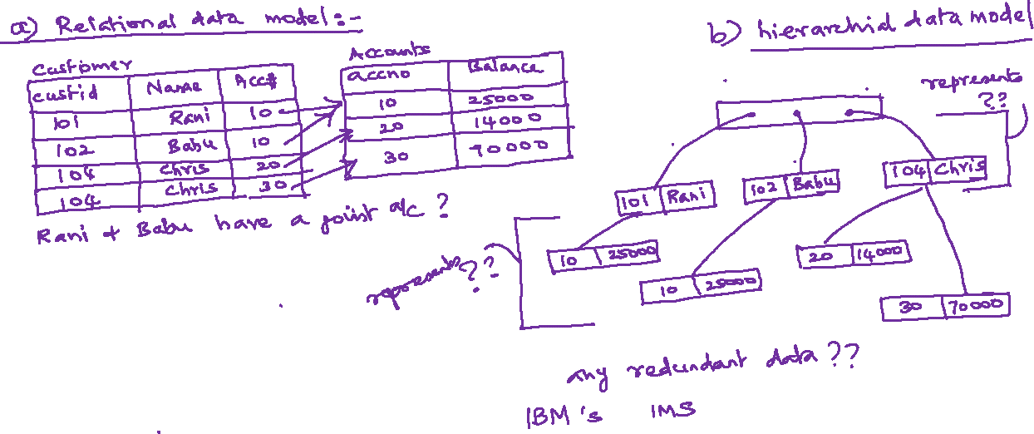


Slide 47
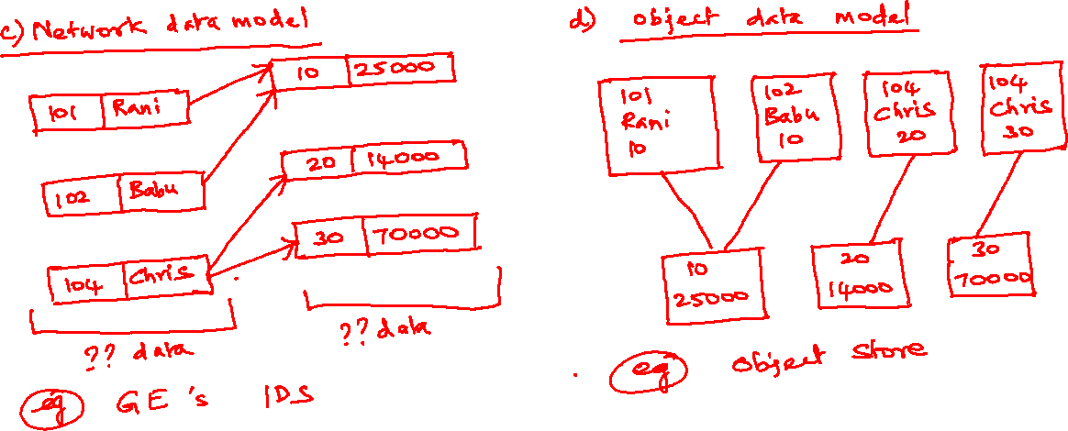

Slide 48
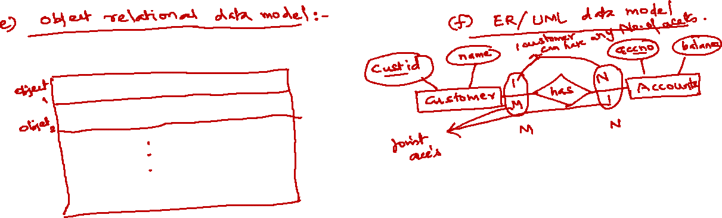

Slide 49
Three-schema architecture

Slide 50
Concept of 3 level or layers of DB
Each Layer has to handle two issues
How to store data
Specify how to view the stored data
Level 1
level2
level3

Slide 51
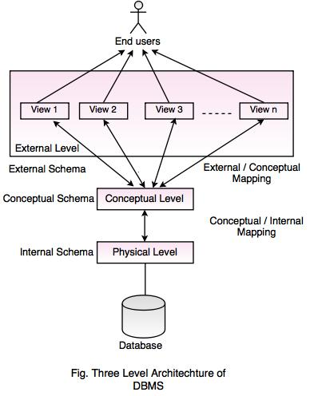
3 Layer architecture

Slide 52
Three schema architecture
The 3 levels or layers of database or DBMS architecture which are External, conceptual or logical and physical or internal levels or layers.
Each Level has a schema and data abstraction
There is a schema at each levels or layers of the Database architecture while there is a abstraction at each levels or layers as well.
These abstractions are called external, conceptual and physical level abstractions respectively.
These abstractions are needed to view data while the schema at each level describe data at some layer of visualization of the database.

Slide 53
External Schema
External schemas, which usually are also in terms of the data model of the DBMS, allow data access to be customized (and authorized) at the level of individual users or groups of users.
Any given database has exactly one conceptual schema and one physical schema because it has just one set of stored relations, but it may have several external schemas, each tailored to a particular group of users.
Each external schema consists of a collection of one or more views and relations from the conceptual schema.
SQL queries we place at this level

Slide 54
Conceptual Schema
conceptual schema (sometimes called the logical schema) describes the stored data in terms of the data model of the DBMS.
In a relational DBMS, the conceptual schema describes all relations that are stored in the database.
Faculty(d: string, fname: string, sal: real)
Courses(cid: string, cname: string, credits: integer)
Rooms(rno: integer, address: string, capacity: integer)
Enrolled(sid: string, cid: string, grade: string)
Teaches(d: string, cid: string)
Meets In(cid: string, rno: integer, time: string
Design of conceptual schemas is called “Conceptual database design”

Slide 55
Physical Schema
The physical schema species additional storage details. Essentially, the physical schema summarizes how the relations described in the conceptual schema are actually stored on secondary storage devices such as disks and tapes.
We must decide what file organizations to use to store the relations, and create auxiliary data structures called indexes to speed up data retrieval operations.
indexes could be by hashing or trees
Decisions about the physical schema are based on an understanding of how the data is typically accessed. The process of arriving at a good physical schema is called physical database design..

Slide 56
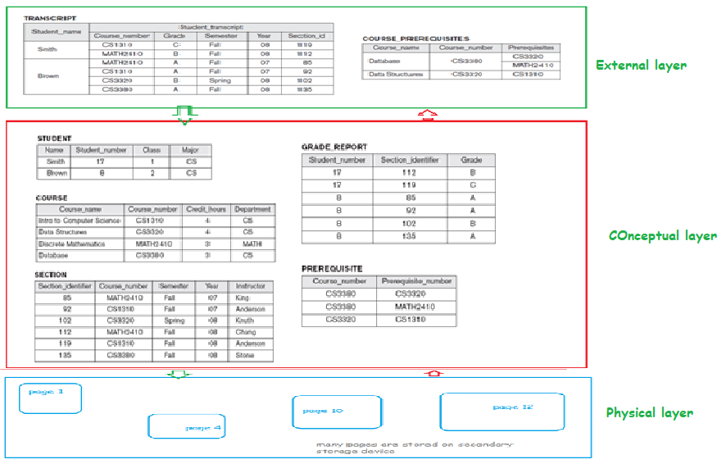
Example 1 : 3-level schema
University db

Slide 57
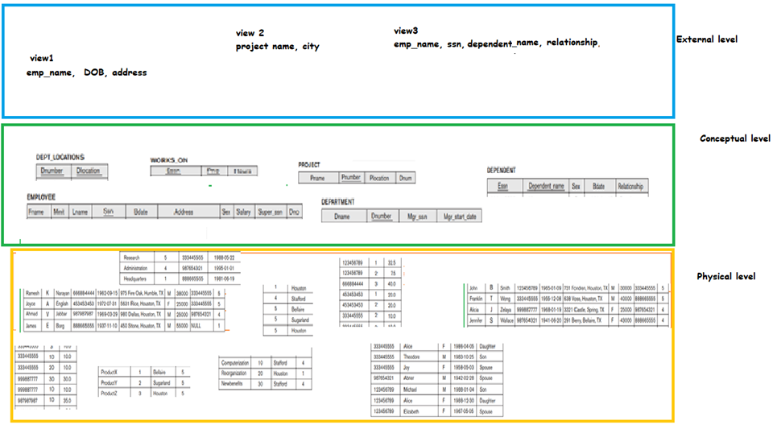
Example 2 : 3-level schema
Company db

Slide 58
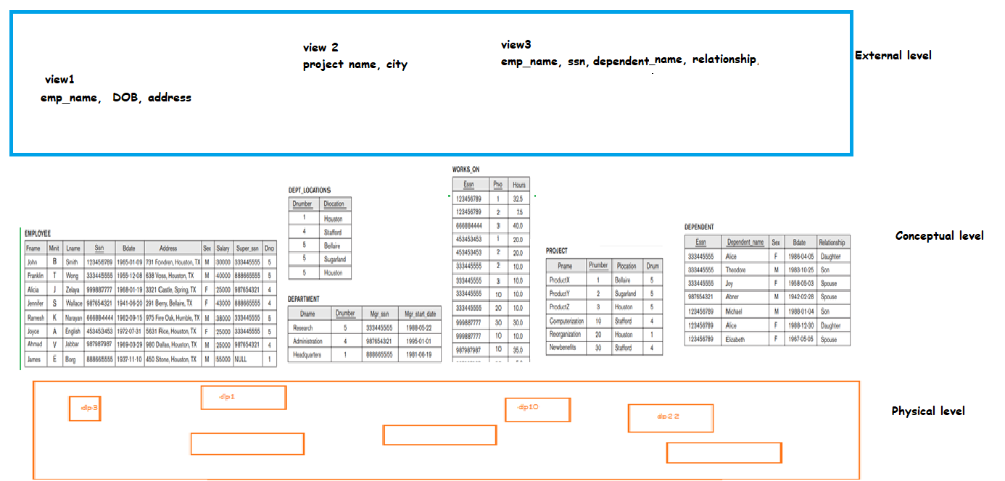
Example 2 : 3-level schema
Company db

Slide 59
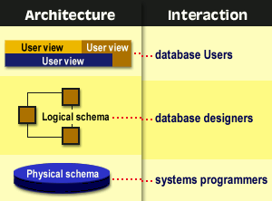

Slide 60
Data Independence
A database system normally contains a lot of data in addition to users’ data.
For example,
it stores data about data, known as metadata, to locate and retrieve data easily. It is rather difficult to modify or update a set of metadata once it is stored in the database.
But as a DBMS expands, it needs to change over time to satisfy the requirements of the users. If the entire data is dependent, it would become a tedious and highly complex job.

Slide 61
DATA INDEPENDENCE
Data Independence
Data Independence is defined as a property of DBMS that helps you to change the Database schema at one level of a database system without requiring to change the schema at the next higher level. Data independence helps you to keep data separated from all programs that make use of it.
Data abstraction or abstraction at each level makes this data independence possible.
Types of data independence
There are two types namely logical and physical data independence.

Slide 62
DATA INDEPENDENCE
Logical data independence:
Logical data is data about database, that is, it stores information about
how data is managed inside.
For example, a table (relation) stored in the database and all its constraints, applied on that relation.
So Logical data independence is a kind of mechanism, which liberalizes itself from actual data stored on the disk. If we do some changes on table format, it should not change the data residing on the disk.

Slide 63
DATA INDEPENDENCE
2. Physical data independence:
All the schemas are logical, and the actual data is stored in bit format on the disk.
Physical data independence is the power to change the physical data without impacting the schema or logical data.
For example, in case we want to change or upgrade the storage system itself − suppose we want to replace hard-disks with SSD − it should not have any impact on the logical data or schemas.

Slide 64
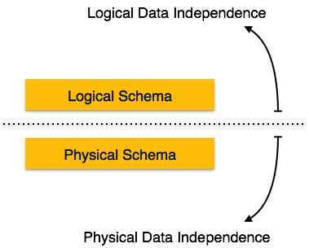
Data Independence
Metadata itself follows a layered architecture, so that when we change data at one layer, it does not affect the data at another level. This data is independent but mapped to each other.

Slide 65
Mapping
Mapping: Mapping is used to transform the request and response between various database levels of architecture. There are two types of mapping namely external and Internal mapping.
In External / Conceptual mapping, it is necessary to transform the request from external level to conceptual schema.
In Conceptual / Internal mapping, DBMS transform the request from the conceptual to internal level.
Note: Mapping is not good for small database, because it takes more time.

Slide 66
Mapping

Slide 67
DBMS ARCHITECTURE

Slide 68
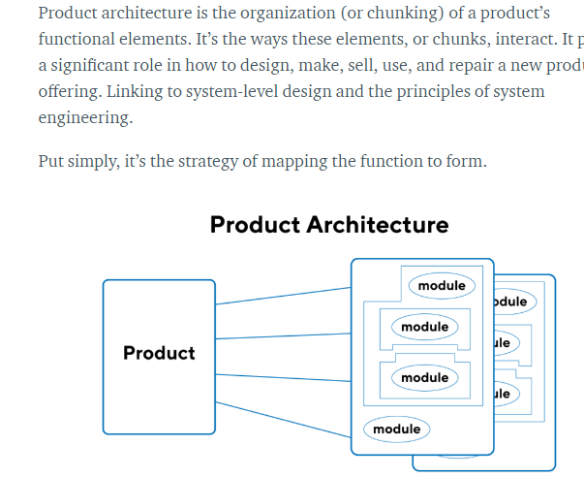
What is architecture?
The software/product architecture of a system represents the design decisions related to overall system structure and behavior.

Slide 69
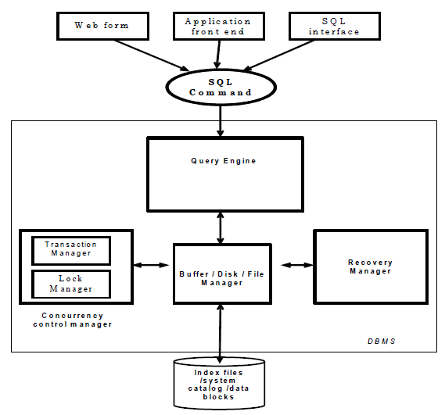
DBMS ARCHITECTURE

Slide 70
Client Server concept
Client and Server concept
The DBMS may be on a centralized machine or server. The clients or end users or programs be it standalone or web/mobile applications accessing the database on the server. There could be several users or apps trying to read or write data on the database located on server.

Slide 71
Types of DBMS Architecture
Types of DBMS Architecture
The types of DBMS architectures are single tier or multi -tier. The n-tier architecture divides the whole system into related but independent n modules which can be modified, altered, changed or replaced independently. There are different layers like presentation layer(UI), application layer (business logic or programs) and data layer where actual database is stored.
1-tier architecture is where the user sits directly on the DBMS and all changes done by DBMS itself. Thus no client or server.

Slide 72
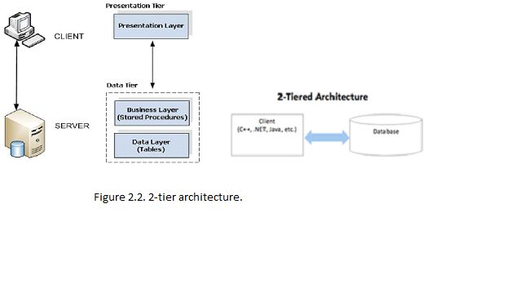
DBMS Architecture
2-tier architecture is where the presentation or UI or app is on your mobile or computer which is the client program and Server which has the database.
The Database is on server so it could be treated that data is safe from unauthorised users.

Slide 73
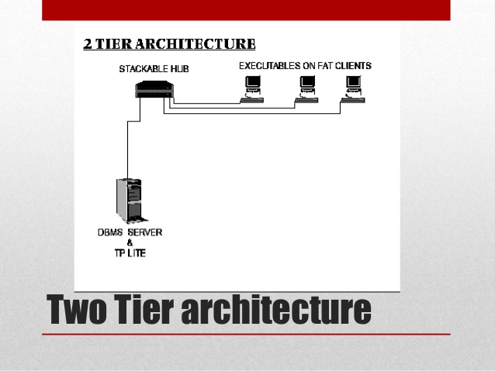
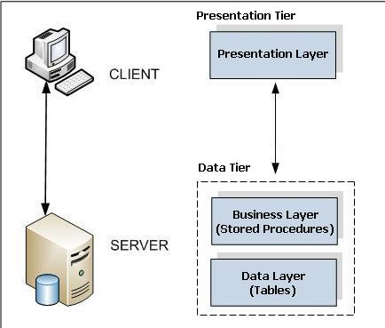
DBMS ARCHITECTURE – 2 TIER

Slide 74
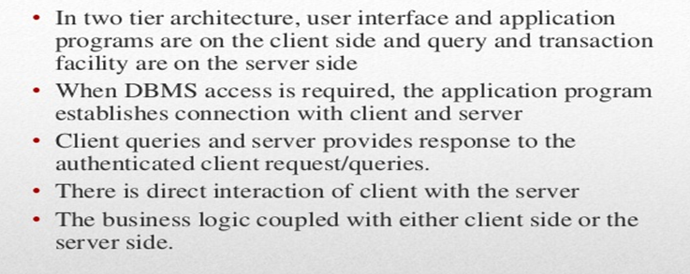
DBMS ARCHITECTURE – 2 TIER

Slide 75
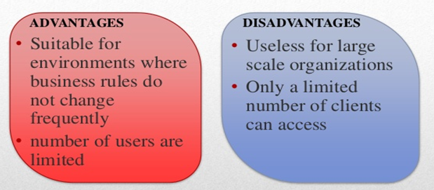
DBMS ARCHITECTURE – 2 TIER

Slide 76
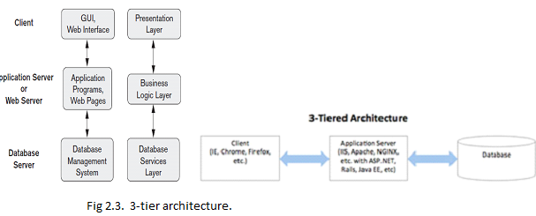
DBMS ARCHITECTURE – 3 TIER
3-tier architecture is where there are 3 layers or modules.
The client or presentation layer which is app on mobile or computer and
server which has the application layer containing business logic modules.
The data layer contains the actual databases.

Slide 77
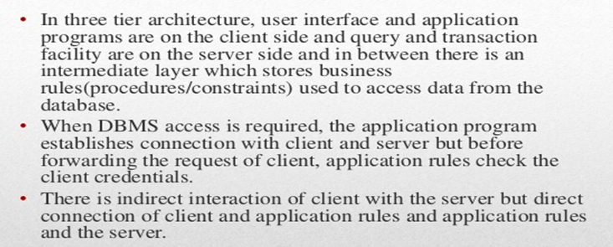
DBMS ARCHITECTURE – 3 TIER

Slide 78
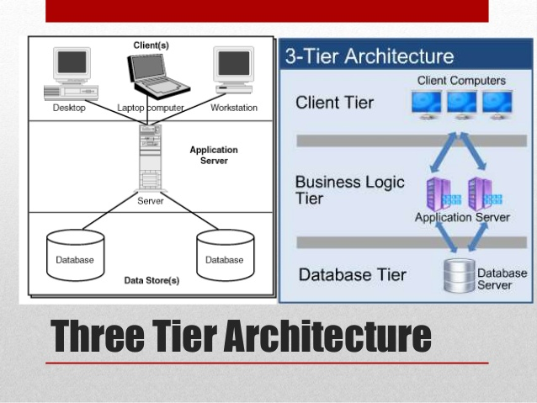
DBMS ARCHITECTURE – 3 TIER

Slide 79
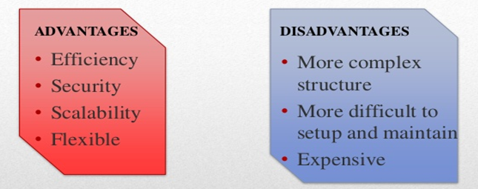
DBMS ARCHITECTURE – 3 TIER

Slide 80
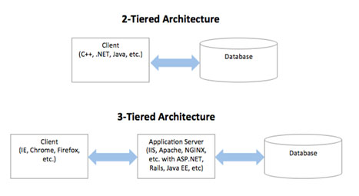
DBMS ARCHITECTURE

Slide 81
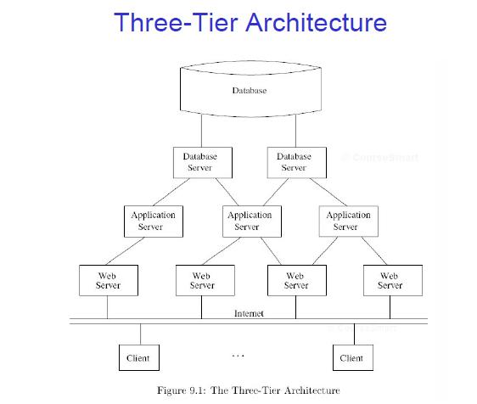
Example of Three-Tier Architecture
A common environment for using a database has three tiers of processors:
Web servers --- talk to the user.
Application servers --- execute the business logic.
Database servers --- get what the app servers need from the database.

Slide 82
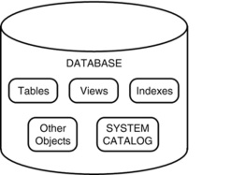
What all are stored in DB?

Slide 83
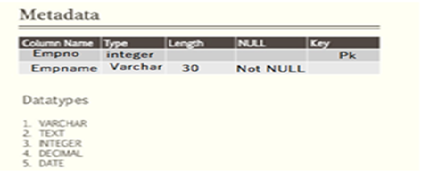
What is METADATA?
Metadata : Data about data is meta data. It describes about itself.
Example

Slide 84
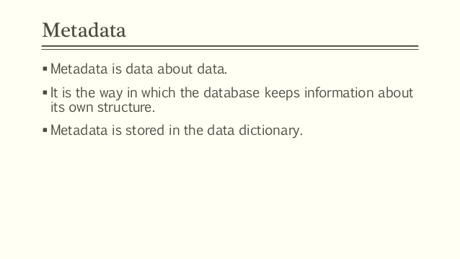
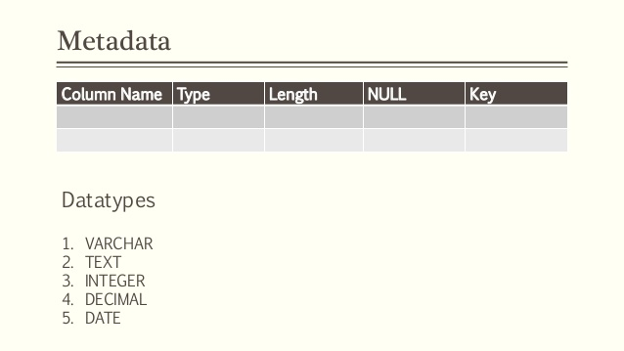
What is Meta data?

Slide 85
DB or SYSTEM CATALOG
Every database stores every information about its objects. These information can be structure, definition, purpose, storage, number of columns and records, dependencies, access rights, owner and other info.
These useful information about the data in the database ,also called as metadata. These metadata are also stored as rows and columns of a table.
Collection of these metadata is stored in the system catalog or data dictionary.
When the database is created a system catalog is automatically created as well.
This catalog keeps track of the objects created and changes made to each objects in the database. Every database has its own system catalog.

Slide 86
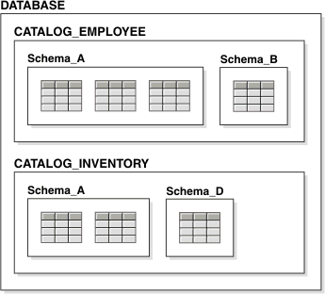
Database / system Catalog
.The information stored in the catalog is called meta-data, and it describes the structure of the primary database

Slide 87
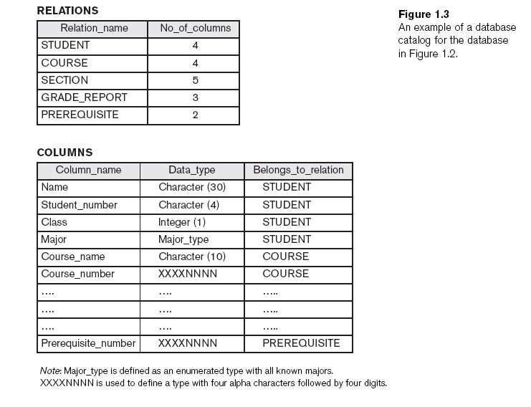
Example of Database Catalog

Slide 88
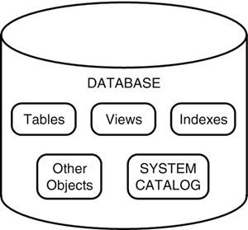
SYSTEM or DB CATALOG
Who creates system catalog?
When you create a database the system catalog is automatically created by DBMS.

Slide 89
SYSTEM CATALOG
The system catalog contains information such as the following:
User accounts and default settings
Privileges and other security information
Performance statistics
Object sizing
Object growth
Table structure and storage
Index structure and storage
Information on other database objects, such as views, synonyms, triggers, and stored procedures
Table constraints and referential integrity information
User sessions
Auditing information
Internal database settings
Locations of database files

Slide 90
What is a Query
Queries in a DBMS :
Queries : Questions involving the data stored in DBMS.
Types of queries :
Formal query language -> Relational Algebra and
Relational Calculus
commercial query language -> SQL statements

Slide 91
DB Architecture

Slide 92
DB architecture
Database Architecture:
Database architecture deals the design, development, implementation and maintenance of computer programs that which store and organize information for businesses, agencies and institutions. The development and implementation software to meet the needs of users is done by Data Architect.
Design of DBMS depends on its architecture which can be centralized or hierarchical.
Data Abstraction: Hiding the implementation and storage details of DB or database.

Slide 93
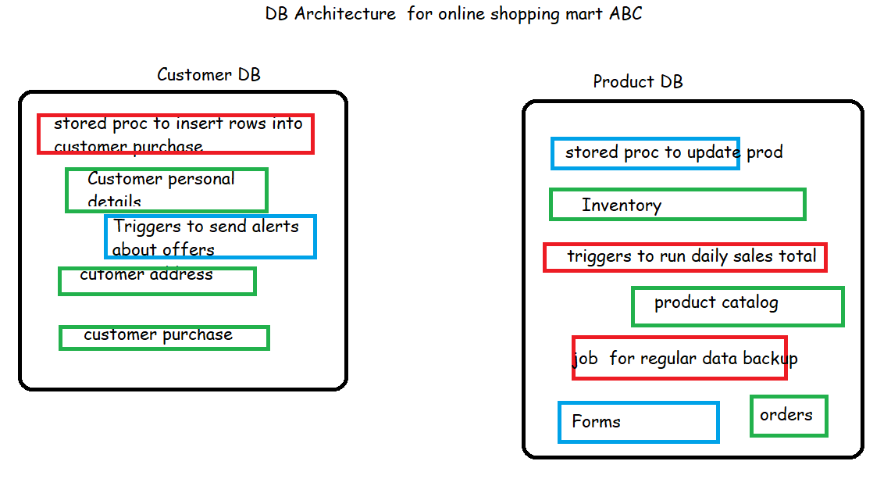
Example of DB architecture
Green ones are tables ,

Slide 94
Data Dictionary
Creating a Data Dictionary for Online Delivery System
Delivery Table – This table contains details about the delivery
Primary Key Attribute Data Type Size Description
Y Delivery_id INTEGER - Unique ID of delivery
Delivery_date Date - Date of the delivery
Delivery_person_name VARCHAR 50 Name of the person who does the delivery of specific order
Delivery_person_contact VARCHAR 20 Name of the person who does the delivery of specific order
Order Table – This table contains details about order
PrimaryKey Attribute Data Type Size Description
Y Order_id INTEGER - Unique Id of order
Cust_id INTEGER - Unique ID of customer
Delivery_id INTEGER - Unique ID of delivery
Date Date - Date of a specific order
Branch_id INTEGER - Unique ID of the branch

Slide 95
DBMS Functions, Pros and cons.

Slide 96
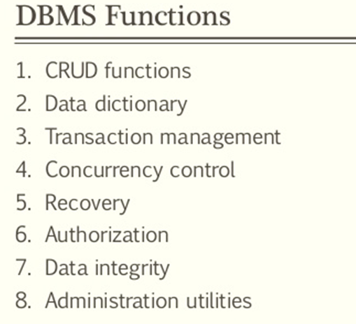
DBMS

Slide 97
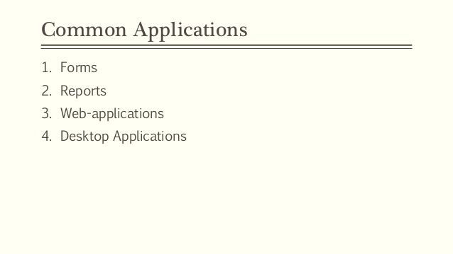
DBMS Applications

Slide 98

DBMS Advantages
Notes:
Controlling redundancy
Data normalization
Denormalization
Sometimes necessary to use controlled redundancy to improve the performance of queries
Restricting unauthorized access
Security and authorization subsystem
Privileged software
Providing storage structures and search techniques for efficient query processing
Indexes
Buffering and caching
Query processing and optimization
Providing persistent storage for program objects
Complex object in C++ can be stored permanently in an object-oriented DBMS
Impedance mismatch problem
Object-oriented database systems typically offer data structure compatibility
Providing backup and recovery
Backup and recovery subsystem of the DBMS is responsible for recovery
Providing multiple user interfaces
Graphical user interfaces (GUIs)
Representing complex relationships among data
May include numerous varieties of data that are interrelated in many ways
Enforcing integrity constraints
Referential integrity constraint
Every section record must be related to a course record
Key or uniqueness constraint
Every course record must have a unique value for Course_number
Business rules A business rule is a rule that defines or constrains some aspect of business . Eg., a business rule might state that no credit check is to be performed on return customers
Inherent rules of the data model
Permitting inferencing and actions using rules
Deductive database systems
Provide capabilities for defining deduction rules
Inferencing new information from the stored database facts
Trigger
Rule activated by updates to the table
Stored procedures
More involved procedures to enforce rules
Additional implications of using the database approach
Reduced application development time
Flexibility
Availability of up-to-date information
Economies of scale

Slide 99

DBMS Disadvantages

Slide 100
WHAT IS ERP OR CRM ?
These packages identify a set of common tasks (e.g., inventory management, human resources planning, financial analysis) encountered by a large number of organizations and provide a general application layer to carry out these tasks.
The data is stored in a relational DBMS, and the application layer can be customized to different companies, leading to lower overall costs for the companies, compared to the cost of building the application layer from scratch.
Extending database capabilities for new applications
Extensions to better support specialized requirements for applications
Enterprise resource planning (ERP)
Customer relationship management (CRM)
Databases versus information retrieval
Information retrieval (IR)
Deals with books, manuscripts, and various forms of library-based articles

Slide 101


ERP
ERP applications are most commonly deployed in a distributed and often widely dispersed manner. While the servers may be centralized, the clients are usually spread to multiple locations throughout the enterprise.
Enterprise Resource Planning software can be used to automate and simplify individual activities across a business or organization, such as accounting and procurement, project management, customer relationship management, risk management, compliance, and supply chain operations.

Slide 102
ERP systems
What are the resources?
money, human resources, machinery, land, telecom spectrum, oil fields, coal mines licenses etc
e-governance
E-seva
ELCOT https://it.tn.gov.in/en/ELCOT/e-interventions
SAP
SAP has multiple ERP offerings – By Design, Manufacturing, and Business One.
Sage
Aimed at firms in manufacturing, distribution and services, Sage offers a suite of products providing a range of key ERP tools.
Microsoft Dynamics
This has developed into a full suite of ERP products, and now includes applications for, amongst other things, financial management, human resources, and supply chain management.
Salesforce.com
Salesforce.com is one the biggest names in ERP and customer relationship management (CRM) solutions, which can be used across a variety of sectors. The firm offers a range of products depending on a businesses’ size and sector.

Slide 103

CRM
Customer Relationship Management(CRM) is a business strategy to acquire and manage the most valuable customer relationships. CRM requires a customer-centric business philosophy and culture to support effective marketing, sales and service processes.
CRM system stores the history of the relationship between seller and customer. Brands optimize employee performance, implement new marketing tools, improve service levels, and drive revenue growth based on this data.

Slide 104
CRM examples
CRM platform includes the following functions:
organizes data for easy interpretation,
prompts CSRs for useful information,
protects against duplicate records,
flags incomplete records.
As a part of the massive software-as-a-service (SaaS) market, CRM technology represents the fastest-growing category of enterprise-software. The major players in the CRM market are Adobe Systems, Microsoft, Oracle, Salesforce, and SAP.
use of CRM in the public domain for quite some time now. These include the IRCTC – the Indian Railways ticketing web portal, the Road Transport Authority services, the Municipal corporations and its allied departments for health and governance as well as legal and utility services such as electricity and gas operators. These have all been progressively managing citizen data and relationships using CRM techniques.
Salesforce Sales Cloud
Zoho CRM
Hubspot

Slide 105



TIMELINE OF DBMS

Slide 106
When Not to Use a DBMS
More desirable to use regular files for:
Simple, well-defined database applications not expected to change at all
Stringent, real-time requirements that may not be met because of DBMS overhead
Embedded systems with limited storage capacity
No multiple-user access to data

Slide 107
DBMS WORKERS or Users
System analysts
Determine requirements of end users
Application programmers
Implement these specifications as programs
DBMS system designers and implementers
Design and implement the DBMS modules and interfaces as a software package
Tool developers
Design and implement tools
Operators and maintenance personnel
Responsible for running and maintenance of hardware and software environment for database system

Slide 108
DBMS WORKERS or Users
Database administrators (DBA) are responsible for:
Authorizing access to the database
Coordinating and monitoring its use
Acquiring software and hardware resources
Database designers are responsible for:
Identifying the data to be stored
Choosing appropriate structures to represent and store this data
End users
People whose jobs require access to the database
Types
Casual end users
Naive or parametric end users
Sophisticated end users
Standalone users

Slide 109
QUESTIONS??

Slide 110
Phases of Database Design

Slide 111
Phases of Database Design
1. Requirements specification and analysis
2. Conceptual design
3. Logical design
4. Physical design

Slide 112

Phases of Database Design

Slide 113

Phases of Database Design

Slide 114


Slide 115
Phases of Database Design
1. Requirements specification and analysis
The requirements and the collection analysis phase produce both data requirements and functional requirements.
The data requirements are used as a source of database design.
The data requirements should be specified in as detailed and complete form as possible.

Slide 116
Phases of Database Design
2. Conceptual design
The result of this phase is an Entity-Relationship (ER) diagram or UML class diagram. It is a high-level data model of the specific application area.
It describes how different entities (objects, items) are related to each other. It also describes what attributes (features) each entity has. It includes the definitions of all the concepts (entities, attributes) of the application area.
During or after the conceptual schema design, the basic data model operations can be used to specify the high-level user operations identified during the functional analysis. This also serves to confirm that the conceptual schema meets all the identified functional requirements.

Slide 117
Phases of Database Design
3. Logical design
A. create relation schemas:
The result of the logical design phase (or data model mapping phase) is a set of relation schemas. The ER diagram or class diagram is the basis for these relation schemas.
To create the relation schemas is quite a mechanical operation. There are rules how the ER model or class diagram is transferred to relation schemas.
The relation schemas are the basis for table definitions. In this phase (if not done in previous phase) the primary keys and foreign keys are defined.

Slide 118
Phases of Database Design
3. Logical design
B. Normalization
Normalization is the last part of the logical design. The goal of normalization is to
eliminate redundancy and potential update anomalies.
Redundancy means that the same data is saved more than once in a database. Update anomaly is a consequence of redundancy. If a piece of data is saved in more than one place, the same data must be updated in more than one place.
Normalization is a technique by which one can modify the relation schema to reduce the redundancy. Each normalization phase adds more relations (tables) into the database.

Slide 119
Phases of Database Design
4. Physical design
The goal of the last phase of database design, physical design, is to implement the database. At this phase one must know which database management system (DBMS) is used.
For example, different DBMS's have different names for datatypes and have different datatypes.
The SQL clauses to create the database are written. The indexes, the integrity constraints (rules) and the users' access rights are defined.
Finally the data to test the database is added in.

Slide 120
Eg, UNIVERSITY database
STEP A: ANALYZE THE PROBLEM
Step1 :
What does this DB do?
Information concerning students, courses, and grades in a university environment
Step2 :
What are the Data records?
STUDENT
COURSE
SECTION
GRADE_REPORT
PREREQUISITE
Step 3:
Step Specify structure of records of each file by specifying data type for each data
element
String of alphabetic characters
Integer
Etc.

Slide 121
UNIVERSITY database contd…
Step B: Relate the records.
Step 4: Construct UNIVERSITY database
Store data to represent each student, course, section, grade report, and prerequisite as a record in appropriate file
Step 5: Relationships among the records
Step 6: Manipulation involves querying and updating

Slide 122
Examples of Queries and Updates:
Examples of queries:
Retrieve the transcript
List the names of students who took the section of the ‘Database’ course offered in fall 2008 and their grades in that section
List the prerequisites of the ‘Database’ course
Examples of updates:
Change the class of ‘Smith’ to sophomore
Create a new section for the ‘Database’ course for this semester
Enter a grade of ‘A’ for ‘Smith’ in the ‘Database’ section of last semester

Slide 123
UNIVERSITY Database designed as:

Slide 124
Analysis of Requirements
RS DOC Writing.
First deliverable for project assignment

Slide 125


Slide 126


Slide 127
DBDudes Inc., a well-known database consulting firm, has been called in to help Barns and Nobble (B&N) with their database design and implementation. B&N is a large bookstore specializing in books on horse racing, and they've decided to go online. DBDudes first verify that B&N is willing and able to pay their steep fees and then schedule a lunch meeting|billed to B&N, naturally to do requirements analysis.
REQUIREMENTS ANALYSIS
The owner of B&N has thought about what he wants and offers a concise summary:
“I would like my customers to be able to browse my catalog of books and to place orders over the Internet. Currently, I take orders over the phone. I have mostly corporate customers who call me and give me the ISBN number of a book and a quantity. I then prepare a shipment that contains the books they have ordered. If I don't have enough copies in stock, I order additional copies and delay the shipment until the new
copies arrive; I want to ship a customer's entire order together. My catalog includes all the books that I sell. For each book, the catalog contains its ISBN number, title, author, purchase price, sales price, and the year the book was published. Most of my customers are regulars, and I have records with their name, address, and credit card number. New customers have to call me first and establish an account before they can use my Web site.
On my new Web site, customers should first identify themselves by their unique customer identication number. Then they should be able to browse my catalog and to place orders online."
DBDudes's consultants are a little surprised by how quickly the requirements phase was completed|it usually takes them weeks of discussions (and many lunches and dinners) to get this done|but return to their oces to analyze this information.

Slide 128
University database:
Professors have an SSN, a name, an age, a rank, and a research specialty.
Projects have a project number, a sponsor name (e.g., NSF), a starting date, an ending date, and a budget.
Graduate students have an SSN, a name, an age, and a degree program (e.g., M.S. or Ph.D.).
Each project is managed by one professor (known as the project's principal investigator).
Each project is worked on by one or more professors (known as the project's co-investigators).
Professors can manage and/or work on multiple projects.
Each project is worked on by one or more graduate students (known as the project’s research assistants).
When graduate students work on a project, a professor must supervise their work on the project.
Graduate students can work on multiple projects, in which case they will have a (potentially dierent) supervisor for each one.
Departments have a department number, a department name, and a main once.
Departments have a professor (known as the chairman) who runs the department.
Professors work in one or more departments, and for each department that they work in, a time percentage is associated with their job.
Graduate students have one major department in which they are working on their degree.
Each graduate student has another, more senior graduate student (known as a student advisor) who advises him or her on what courses to take.

Slide 129
Problem Statement:
WorldLib WL our client runs a huge library and serves journals, books, periodicals to their customers/ members of WL who are from different age groups, race and color, rich and poor. Their policies are to serve downtrodden communities especially help students and unemployed youths to make use of books to upgrade their knowledge. WL has many books covering a wide range of discipline of studies and all fields including tech and non tech. They have a catalog which has books details which the library has and members can browse for their books. Each customer has to register themselves with an id proof which has personal details like NI or SSN or aadhar, name, profession, Working/not, work address, college/school/uni and address, DOB, phone number, emailid. Once they are registered successfully then an id card is issued with a membership number which has to be a 15 to 17 character starting with “S” and 14 digits for school students, college its “C” 14 digit number and for university students “U” followed by 14 digit number. And if Professional like Tech then “T” followed by 14 digit number and for non tech its “NT” 14 digit number.
Age of members can be from toddler to super senior citizens. Each member will be given 4 tickets and 1 book can be borrowed for a ticket. Members can borrow a book for 15 days and return books by the due date. The policies WL ……
Each book has author name, publishername, edition, year of publication, no of pages, book price, no of copies, ISBN. ….. The library has a Director and set of staffs tech and non tech. The books will be issued and returned books will be handled by Librarians only. One librarian can handle any number of returns and issues. There are some 200 librarians. ……

Slide 130

The following functionalities are required:1.Issue of books:
•
A member should be able to issue books.
•
Each member can issue only a single book.
•
The software takes the current system date as the date of issue andcalculates the date of return.
•
The due date for the return of the book is stamped on the book.
2.eturn of books:
•
Any person can return the issued books {if they have the member code).
•
The system displays the member's details on whose name the book is issued as well as the date of issue and return of the book,
•
The information is saved and the corresponding updating takes place in thedatabase.
!."uery #rocessing:
•
eal time searching.
•
!uery processing will also include catalogue searching.
•
"ubstrings will be allowed
.
REQUIREMENT SPECIFICATION DOCUMENT and PROBLEM STATEMENT
They also have funds from elite and rich and humble people who donate to buy books so that the younger and all generations benefit knowledge. So keep track of funds , book procurement, inventory of books.
Damaged books and policies determining how it will replaced ? Fine ie., book price or nominal amount due to members financial status or new book??
For Late renewal fine(how much the is the fine , what are policies w.r.t this?) or how many time such late renewal allowed?? If this repeated often will their membership be cancelled?
What is cancellation policies by WL??

Slide 131
REQUIREMENT SPECIFICATION DOCUMENT and PROBLEM STATEMENT
WL wants to digitize their library operations and procurement of books for their library.
Login
Register members
Cancel membership
Issue of book
Return book
Fine and book damage cost calculation
Report generation
Catalog updation
Procurement of books
Funds handling
Inventory of books

Slide 132
SUM UP

Slide 133
THANK YOU

